Slide 1

Project A-z handyman
Developer: Thien Duong
University of Houston-Downtown
Fall 2020

Slide 2
Progress since last meeting
Added Laborer page
Built laborer’s components
Implement CRUD model for each laborer
Create add new laborer function
Create delete each laborer function
Created delete all laborers function
Created edit laborer function

Slide 3
Project Architecture (for frontend components)
GitHub repos: https://github.com/ducthien97/AZHandyMan
Folder src/:
main.js: Main controller of application
components: Components’ folder consist of all components to be rendered
ActiveUser.vue: render the laborer’ information
UserData: form to create new laborer
EditUser.vue: used to edit user data
App.vue: Vue file to input data to interact with components

Slide 4
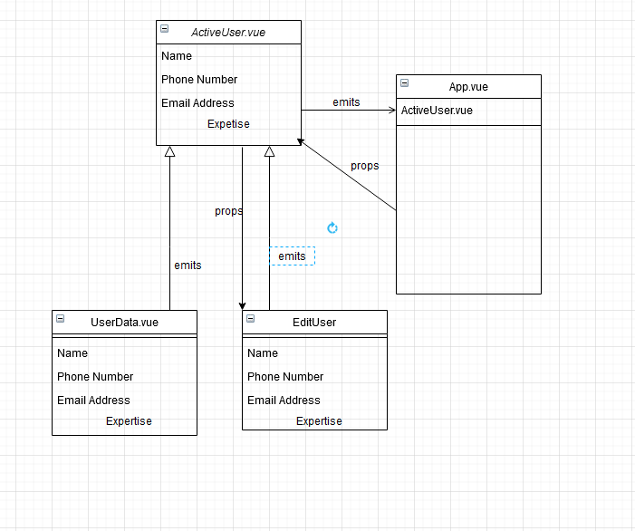
Diagram

Slide 5
Progress to be made before next meeting
Build API for backend
Finish Frontend components and routes
Get start on mongoDB

